Slide 1
The Asia-Pacific School and Workshop on Gravitation and Cosmology 2023
Overview of Extra Dimensions
Yu-Xiao Liu 刘玉孝
Lanzhou University 兰州大学
19 May 2023, Hongzhou

Slide 2
Outline
1. Motivation
2. Extra dimensions and thin brane models
  Kaluza-Klein (KK) theory
  Large extra dimensions
  Warped extra dimensions
  New extra dimensions
3. Thick brane and gravity
4. Localization of matter fields
5. Gravitational waves and extra dimensions
6. Prospect

Slide 3
1. Motivation
Why extra dimensions?

Slide 4
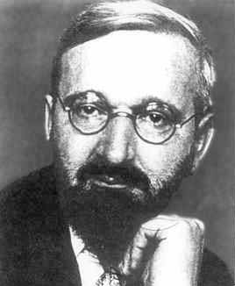

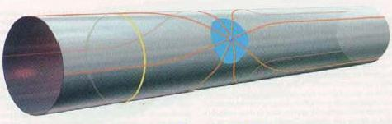
Motivation 1: Kaluza-Klein theory (1920’)
In order to unify 4D gravity and electromagnetic.
This was done by assuming that the photon field originates from fifth component (g_{μ5}) of a 5D metric tensor.
Extra dimension
Planck scale
X¹, x², x³
T. Kaluza, Sitzungsber. Preuss. Akad. Wiss. Berlin (Math. Phys. ) 1921, 966 (1921);
O. Klein, Z. Phys. 37, 895 (1926).
Notes:
Extra dimensions were first introduced in the 1920’s by Kaluza and Klein, who were trying to unify 4D gravity and electromagnetism, by assuming that the photon field originates from fifth component (gμ5) of a 5D metric tensor.
German mathematics teacher Theodor Kaluza
Swedish physicist Oskar Klein

Slide 5
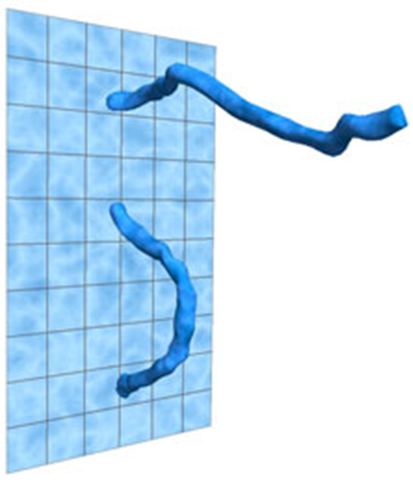
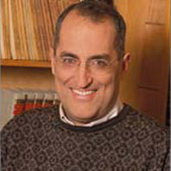
Motivation 2: String/M theory （1980’）
Superstring/M theory needs more dimensions:
  For a classical string, any dimension is allowed.
  But a consistent theory of a quantum string will need special dimensions: 10 or 11
Size of extra dimensions in string theory is Planck length
Goal: unify four fundamental interactions
Notes:
A consistent string theory will necessarily include extra dimensions.
In order for such theories with extra dimensions to not flatly contradict with our observed four space-time dimensions, we need to be able
to hide the existence of the extra dimensions in all observations that have been made to date.

Slide 6
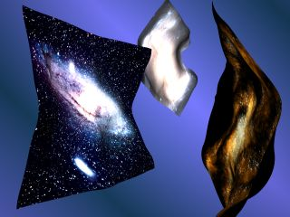
Motivation 3: Phenomenon Interesting
Gauge hierarchy problem (Why gravity is so weak? ）
Solutions
  Supersymmetry
  Large extra dimensions
  Warped extra dimensions
  Technicolor, Higgsless
  Gauge-Higgs Unication
  Pseudo-Goldstone Higgs
M_{pl} ~ 10¹⁶TeV >> M_{EW} ~ 1TeV ？
Our 4D universe is brane in the bulk

Slide 7
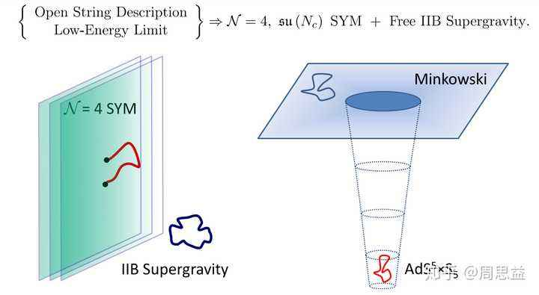
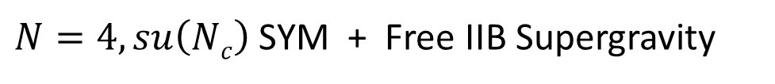
Motivation 4: AdS/CFT
Applications in AdS/CFT
Open String Description
Low-Energy Limit
$N=4, su\left(Nc\right)$SYM + Free IIB Supergravity
S.Y. Zhou

Slide 8
2. Extra dimensions and thin brane models

Slide 9
2.1 Kaluza-Klein theory
Unify 4D gravity and electromagnetic
T. Kaluza, Math. Phys. 1921
O. Klein, Z. Phys. 1926
y
r
X¹, x², x³
Notes:
German mathematics teacher Theodor Kaluza
Swedish physicist Oskar Klein

Slide 10


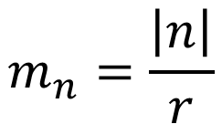
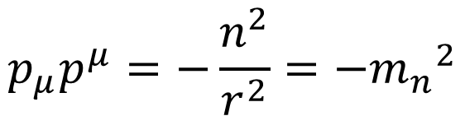
2.1 Kaluza-Klein theory
Unify 4D gravity and electromagnetic
y
r
periodic condition
X¹, x², x³
The periodic condition results in a series of KK modes
All zero modes describe the observed particles.
Acceptable radius r: r < TeV⁻¹ ~ 10⁻¹⁷cm
No hope for Planck scale r ~ l_{Pl} ~ 10⁻³³cm?
$$φ(x,y)=φ(x,y+2πr)$$
$$m_{n}=\frac{\left|n\right|}{r}$$
$$p_{μ}p^{μ}=−\frac{n^{2}}{r^{2}}{=−m_{n}}^{2}$$
$${p_{N}p}^{N}=0$$
massive KK mode
KK zero mode
Notes:
German mathematics teacher Theodor Kaluza
Swedish physicist Oskar Klein
In order for such theories with extra dimensions to not flatly contradict with our observed four space-time dimensions, we need to be able
to hide the existence of the extra dimensions in all observations that have been made to date.

Slide 11
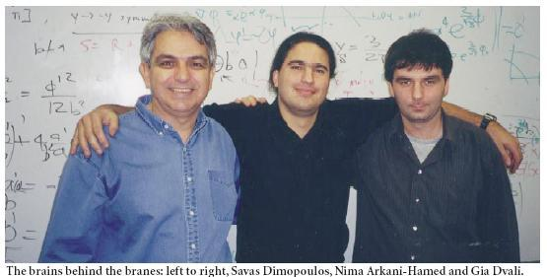

2.2 Large extra dimensions
Arkani-Hamed, Dimopoulos, Dvali (ADD)
Phys. Lett. B 429 (1998) 263
In order to solve the gauge hierarchy problem,
they introduced large extra dimensions and brane
ADD braneworld

Slide 12
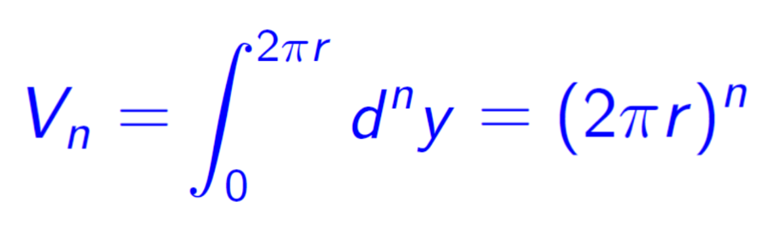
2.2 Large extra dimensions
Assume
KK reduction from D=4+n dimension to 4 dimensions:
M: fundamental mass scale
M_{Pl}: effective mass scale

Slide 13
2.2 Large extra dimensions
How to resolve hierarchy problem?
Why M_{Pl} ~ 10¹⁶TeV >> M_{EW} ~ 1TeV ？
Introduce a brane; matters are localized on the brane.
In higher-dimensional spacetime, fundamental scales are TeV:
M~1 TeV, M_{EW} ~ 1 TeV
So, there is no hierarchy problem between M and M_{EW} in high dimensions.
4D gravity scale M_{Pl} is an effective scale, it is very high because of large extra dimensions:

Slide 14
2.2 Large extra dimensions
Large extra dimensions

Slide 15
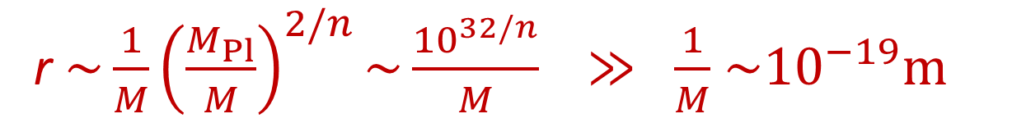
2.2 Large extra dimensions
Fundamental scale is TeV: M~1 TeV,
Large extra dimensions : R_{ED} < 0.1mm for 4+2 dimensions
New hierarchy
（华科的实验: 50微米量级）
r $\sim \frac{1}{M}{\left(\frac{M_{Pl}}{M}\right)}^{2/n}\sim \frac{{10}^{32/n}}{M}$ $≫ \frac{1}{M}$ ${\sim 10}^{−19}m$
resolution
Warped extra dimensions

Slide 16
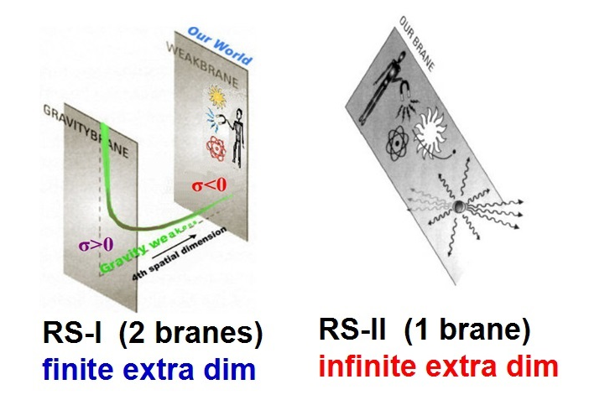
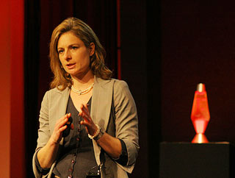
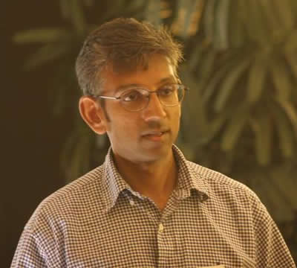
2.3 Warped extra dimensions
Randall Sundrum
PRL 83 (1999) 3370;
PRL 83 (1999) 4690.
Randall-Sundrum braneworld

Slide 17
2.3 Warped extra dimensions
The large extra dimension (ADD) model eliminates the large hierarchy between the fundamental Planck scale M∗ and the scale of weak interactions M_{EW} but introduces the hierarchy between E~1/r and the scale of weak interactions. Therefore, other mechanisms are needed to address this problem.
Randall and Sundrum considered the tension of the brane itself, that is, the effect of the brane on the background space-time.
The influence is that the spacetime outside the brane is curved.
Notes:
ADD 模型消除了弱电能标和Planck 能标之间的层次，但是引入了E~1/r 和弱电能标之间的层次。因此，需要其它方法解决这一问题。
RS 膜世界考虑了膜本身的张力，即考虑膜的存在对于背景时空的
影响，膜之外的时空是弯曲的。
膜的弯曲通过度规中的弯曲因子来体现，其意义在于能够比较完美的解决层次问题，不再对额外维的大小有人为的要求。
这也是该理论的成功之处，是膜世界理论进一步发展的基石。

Slide 18
2.3 Warped extra dimensions
The influence is reflected by the warped factor in the metric, which indicates that it may perfectly solve the gauge hierarchical problem, and we no longer have artificial requirements for the size of extra dimension.
This is also the success of the theory and the cornerstone for further development of the brane world theory.
Notes:
ADD 模型消除了弱电能标和Planck 能标之间的层次，但是引入了E~1/r 和弱电能标之间的层次。因此，需要其它方法解决这一问题。
RS 膜世界考虑了膜本身的张力，即考虑膜的存在对于背景时空的
影响，膜之外的时空是弯曲的。
膜的弯曲通过度规中的弯曲因子来体现，其意义在于能够比较完美的解决层次问题，不再对额外维的大小有人为的要求。
这也是该理论的成功之处，是膜世界理论进一步发展的基石。

Slide 19


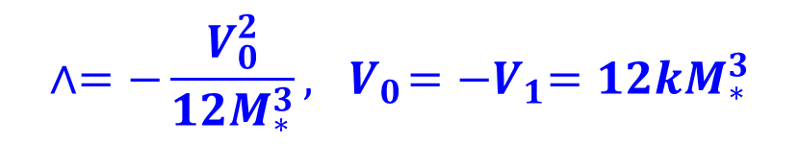
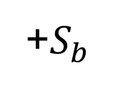










2.3 Warped extra dimensions
$$\int{d^{4}x V_{0,1}\sqrt{g_{0,1}^{ind}}}$$
The action, metric, and bulk EoMs:
[PRL 83 (1999) 3370]
$$S^{1}$$
+$S_{b}$
$$πr_{c}$$
$$y=0$$
$dS^{2}=e^{2A(y)}η_{μν}dx^{μ}$ $x^{ν}+dy^{2}$
$$y↔−y$$
Warp factor
$$S^{1}/Z_{2}$$
The solution is
$$V_{1}$$
$$V_{0}$$
$$∧=−\frac{V_{0}^{2}}{12M_{∗}^{3}}, { V}_{0}={−V}_{1}=12kM_{∗}^{3}$$
$$y=πr_{c}$$
$$y=0$$
$A\left(y\right)=−k|y|$,
orbifold
There is a static flat brane solution, if the above
two fine tuning conditions are satisfied.

Slide 20


2.3 Warped extra dimensions
Solve the gauge hierarchy problem
[PRL 83 (1999) 3370]
Higgs
Consider a scalar field (Higgs) on the negative tension brane at y=b.
TeV
brane
Planck
brane
$$0$$
$$y=b$$
the induced metric at the negative tension
By defining , we get the action for a normal Higgs scalar with the VEV
Thus, all mass scales are exponentially suppressed on the negative tension (TeV) brane, but not on the positive tension (Planck) brane.

Slide 21

2.3 Warped extra dimensions
The effective scale of gravity (the 4D Planck scale)
Higgs
Assume that the 4D graviton h_{μν} is embedded into the full 5D metric
$$0$$
$$y=b$$
The 4D effective gravitational action
from which we obtain the 4D effective Planck scale
If all bare parameters M∗, k, V₀, v are of the same order of the Planck scale,
then while the scale of the Higgs VEV (the weak scale) gets exponentially suppressed,
the scale of gravity itself will remain of the order of the Planck scale.

Slide 22




2.3 Warped extra dimensions
Fundamental scale M* is Planck scale
Warped extra dimension:
Solve hierarchy problem
$dS^{2}=e^{−2k|y|}η_{μν}dx^{μ}$ $x^{ν}+dy^{2}$
$(e^{−kb}\sim {10}^{−16}, b\sim 37/k)$
$$MPl\sim M_{∗}$$
$MEW\sim e^{−kb}M_{∗}\sim 1 TeV$

Slide 23

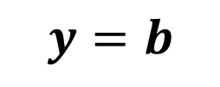
2.3 Warped extra dimensions
Gravity is localized around the Planck brane.
Observers living on the TeV brane will only feel the tail end of the graviton wave function, thus, gravity is very weak.
Newton potential can be recovered with a correction term even for an infinite extra dimension (RS-2 brane).
Higgs
TeV brane
Planck brane
$$y=0$$
$$y=b$$
graviton zero mode
zero mode
massive modes

Slide 24


2.4 New warped extra dimensions
Hierarchy problem
Warped extra dimension(s) (Randall-Sundrum)
Higgs
$$0$$
$$y=b$$
Other mechanisms?

Slide 25


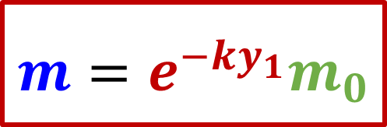

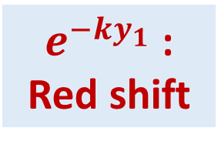
2.4 New warped extra dimensions
Observation: Red shift
Higgs
$dS^{2}=e^{−2k|y|}η_{μν}dx^{μ}$ $x^{ν}+dy^{2}$
$$y1$$
$$y$$
$$m=e^{−ky_{1}}m_{0}$$
m: Physical mass
on brane
$e^{−ky_{1}}$:
Red shift
m₀: Fundamental mass
in bulk

Slide 26






2.4 New warped extra dimensions
Two ways for hierarchy problem
RS1 model: m = 10⁻¹⁶m₀
Fundamental scales: 10¹⁶ TeV
GR:
our model: m = m₀
Fundamental scales: 1 TeV
Non-minimal coupling gravity
Higgs
Higgs
$$ψR$$
M_{Pl}:
blue shift
m:
Red shift
$$R$$
$$0$$
$$y=b$$
$$0$$
$$y=b$$
K. Yang, YXL etc. PRD 86 (2012) 127502;
B. Guo, YXL, K. Yang, S.W. Wei, PRD 98 (2018) 085022.
Randall and Sundrum, PRL 83 (1999) 3370

Slide 27




2.4 New warped extra dimensions
$M_{∗} \sim {10}^{16}TeV$
$R_{ED} \sim 10 l_{Planck}$
$Δm_{KK}\sim 1TeV$
$R_{Newton} <{10}^{−17}cm$
$M_{∗} \sim 1TeV$
$R_{ED} \sim 10 {TeV}^{−1} \sim {10}^{−16}cm$
$Δm_{KK}\sim {10}^{−4}eV$
$R_{Newton} <0.1mm$
Deviation from inverse square law of gravity
$$R$$
$$ψR$$
Higgs
Higgs
$$0$$
$$y=b$$
$$0$$
$$y=b$$
K. Yang, YXL etc. PRD 86 (2012) 127502;
B. Guo, YXL, K. Yang, S.W. Wei, PRD 98 (2018) 085022.
Randall and Sundrum, PRL 83 (1999) 3370

Slide 28
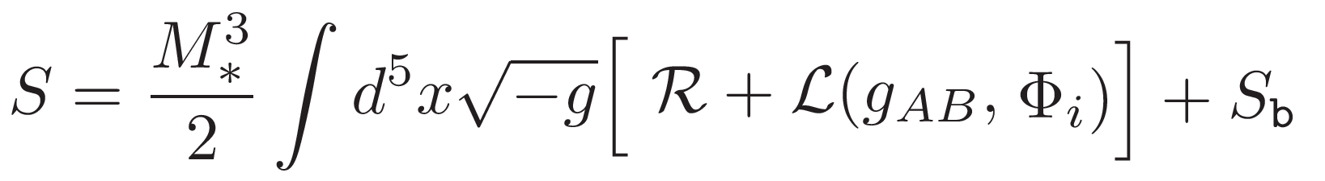
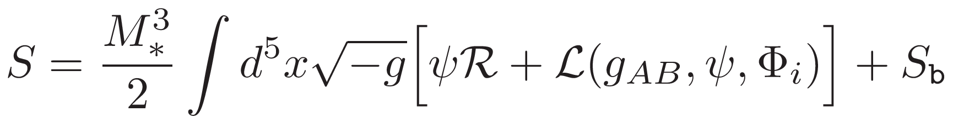
2.4 New warped extra dimensions
Minimal coupling brane
Non-minimal coupling brane
Randall and Sundrum, PRL
Yang, Guo, Liu et al,
PRD 86(2012)127502;
PRD 98 (2018) 085022
10⁻¹⁶mm
Micron to submillimeter
It is difficult to check this model with gravity experiments
It may be checked with gravity experiments
Deviation from inverse square law of gravity

Slide 29
Other models
DGP brane universe
Extra dimensions with screening mechanism
Infinite and warped extra dimensions
Universal extra dimensions
……

Slide 30
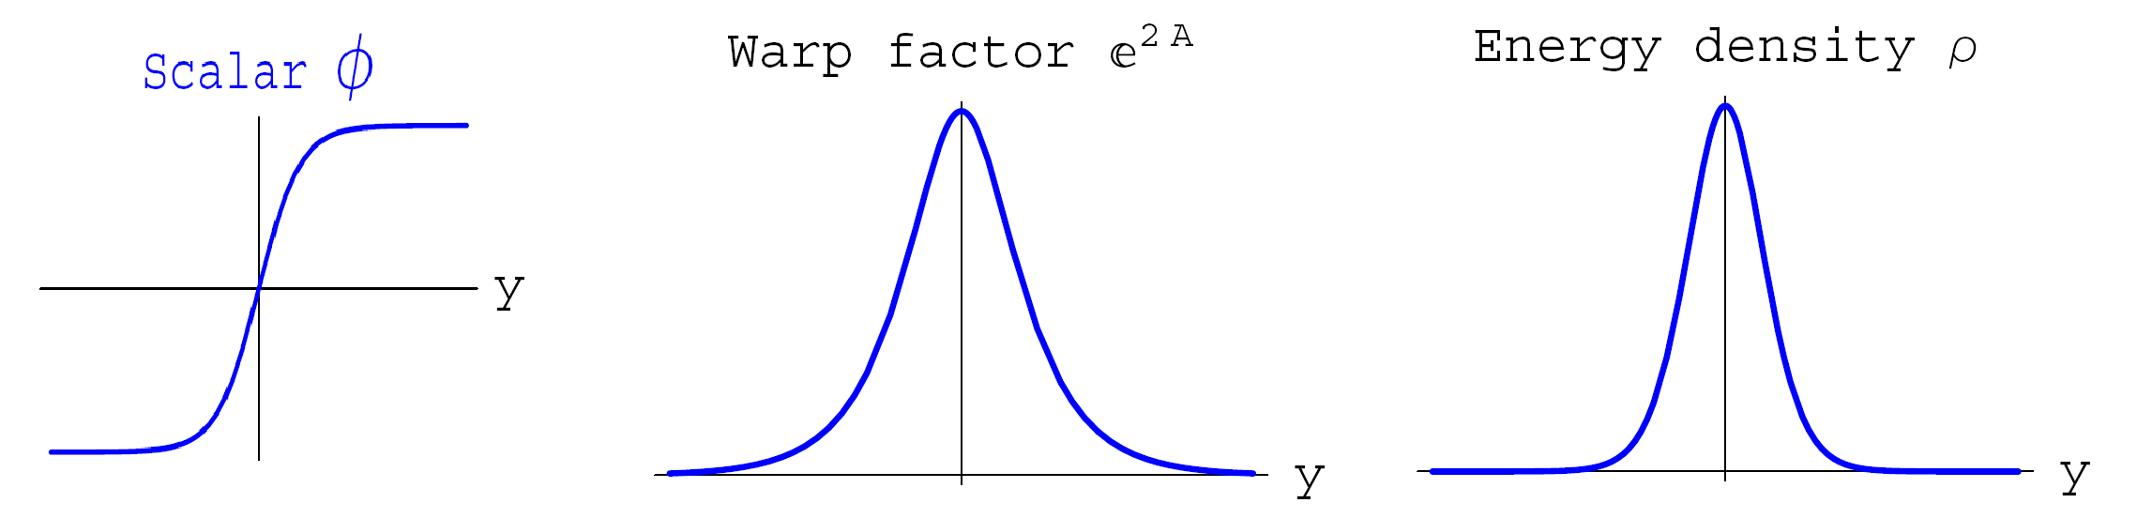
3. Thick brane and gravity

Slide 31
3.1 Brane in GR
The system is described by the action
The 5D metric

Slide 32
3.1 Brane in GR
2000 Flat brane [Dewolfe etc. hep-th/9909134]
2000 dS brane [Gremm hep-th/9912060]
2006 AdS brane [Afonso etc. hep-th/0601069]

Slide 33
3.1 Brane in GR
2012 Stability of K-brane [Y. Zhong, YXL, arXiv:1212.1871]
2014 Stable K-brane [Y. Zhong, YXL etc. arXiv:1401.0004]
  Gravitational perturbations are stable.
  4D gravity can be recovered on the brane.

Slide 34
3.2 Brane in f(R) gravity
Why f(R) grivaty?
Renormalizable gravity.
Has been successfully applied in discussing dark energy, inﬂation, black hole, …...

Slide 35

f(R) thin brane
3.2 Brane in f(R) gravity
2007 Israel junction condition:
  --Balcerzak etc. [arXiv:0710.3670]
  --Dabrowski etc. [arXiv:0711.1150
2010: brane cosmology:
  --Bouhmadi-Lopez etc. [arXiv:1001.3028]
……
$$y$$

Slide 36
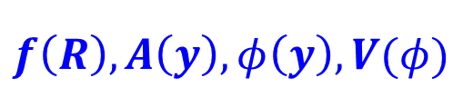
f(R) thick brane
3.2 Brane in f(R) gravity
The model
2007 Analytical solution [Afonso etc. arXiv:0710.3790]:
  --Solution has a singular point
2009 Numerical solution [Dzhunushaliev etc. arXiv:0912.2812]:
  --It is hard to discuss more complex problems.
  --Without scalar field, fermions can not localized on brane.
$$f\left(R\right),A\left(y\right), φ\left(y\right), V(φ)$$

Slide 37
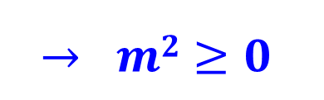
f(R) thick brane
3.2 Brane in f(R) gravity
2010 Stability of Tensor perturbation
[YXL, Y. Zhong etc. 1104.3188]
$$→ m2≥0$$

Slide 38
f(R) thick brane
3.2 Brane in f(R) gravity
2011 The first exact solution [YXL, Y. Zhong etc. 1104.3188]
2012 Brane in Pure f(R) gravity [H Liu, H Lü, Z.L. Wang, 1111.6602]
2013 General solution [Bazeia etc. PLB 1311.6294]

Slide 39
f(R) thick brane
3.2 Brane in f(R) gravity
2014 Approximate Palatini f(R) solution [Bazeia 1411.0897]
2014 Exact Palatini f(R) solution
[B.M. Gu, YXL etc. 1411.3241]
  4D gravity can be recovered, with a tiny correction.

Slide 40
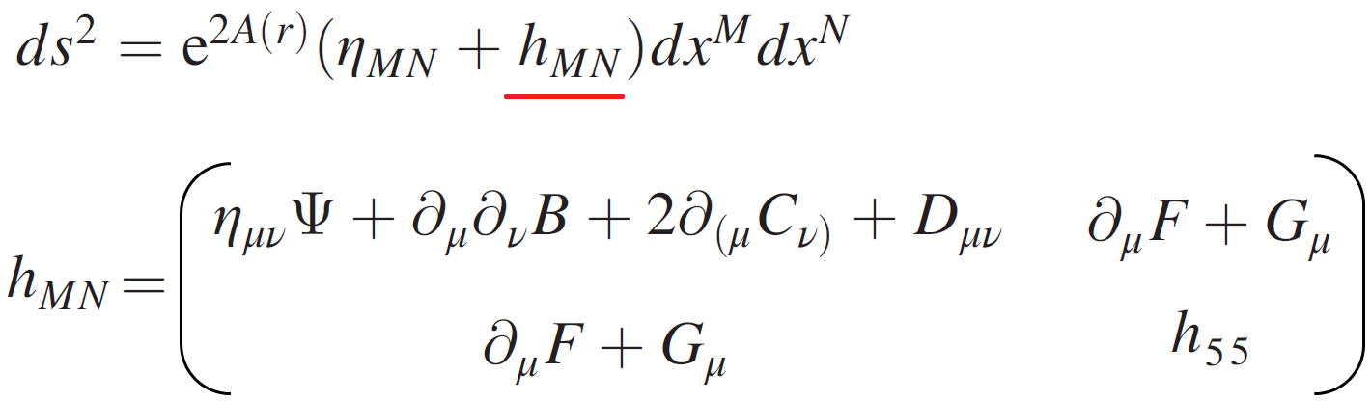
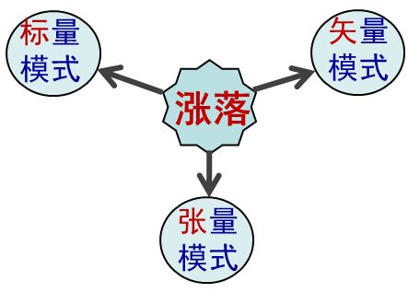
3.3 Gravity on brane

Slide 41
4. Localization of matter fields

Slide 42
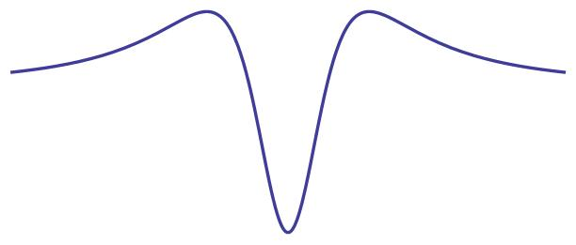
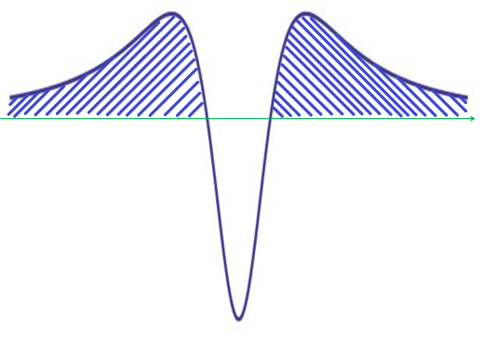
4. Localization of matter fields
All matter fields are in the bulk
  Localized Zero modes——SM.
  Massive KK modes——beyond SM.
V(y)
V(y)
y
y
The zero mode trapped in potential well

Slide 43
4.1 Scalar fields
The action of a 5D free massless scalar field
KK decomposition
The effective action of 4D KK modes

Slide 44
4.1 Scalar fields
Flat brane:
one localized mode
dS brane:
two localized modes

Slide 45

4.2 Vector fields
The action of a 5D free vector field
KK decomposition
The effective action of 4D KK modes
$$A5=0$$

Slide 46
4.2 Vector fields
Flat brane: no localized mode
dS brane: one localized mode [H. Guo, YXL etc PRD 1103.2430]

Slide 47
4.2 Vector fields
How to localize vector zero mode on flat brane?
  Kinetic coupling [Chumbes etc 1108.3821], [ZH Zhao, YXL, Y Zhong 1402.6480]
  Yukawa-like coupling [Vaquera-Araujo etc 1406.2892]
  [Z.-H. Zhao, Q.-Y. Xie, and Y. Zhong 1406.3098]
  Other Mechanisms

Slide 48
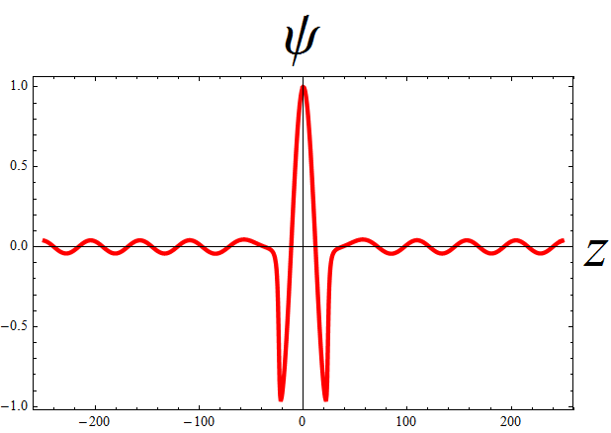
4.3 Fermion fields
Similar results, but more complex
  Need Yukawa coupling
  Only left-hand fermion zero mode can be localized
  Massive Dirac fermion KK modes
  Resonant fermions quasi-localized on brane
  YXL, C.E. Fu, H. Guo, Z.H. Zhao, H.T. Li, Y.P. Zhang, J.J. Wan, etc:
  0708.0065, 0804.4553, 0904.1785, 0907.4424, 1101.0336, 1103.2430, 1312.4145, 1408.6155, 1701.02429, 2303.06278 ……
有效势
额外维

Slide 49
4.4 q-form fields
The q-form field X is an antisymmetric field
Its field strength is expressed as
Hodge duality: q-form is dual to (p-q)-form in D=p+q+1spacetime
The action for the q-form field is

Slide 50
4.4 q-form fields
The two effective actions on the brane of the n-level KK modes of the bulk q-form and its dual (p-q)-form fields are equal.
The duality relations in bulk and on brane are listed as follows.
  C.E. Fu, Y.X. Liu et al: JHEP 1901 (2019) 021; PLB 757 (2016) 180;
  PRD 93 (2016) 064007; PLB 735 (2014) 7; JHEP 1210 (2012) 060.

Slide 51
5. Gravitational waves & extra dimensions

Slide 52
5. Gravitational waves & extra dimensions
GWs provide a new way to detect extra dimensions
  the number of extra dimensions could affect
  amplitude of GWs
  the structure of extra dimensions could lead to
  shortcut of GWs

Slide 53

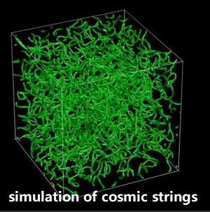
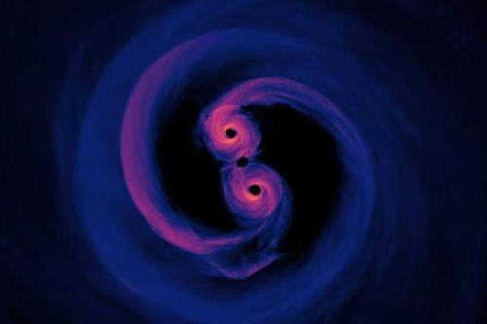
Sources of GWs
Phase
I
Phase
II
Primordial universe
Phase transition
Cosmic strings
Binary systems
Black string
Notes:
Primordial universe
Phase transitions
Cosmic (super-)strings
Binary systems
Black string
……

Slide 54
Primordial universe
GWs in 5D AdS space-time [PLB 489, 259 (2000)]
  GWs can be formed during the inflation.
  At high energy (during the inflation)： GWs could extend into the bulk and the amplitude of GWs on brane is enhanced.
  At low energy: the spectra of GWs will be recovered to the case of the standard GR.
Notes:
At high energy (during the inflation)： GWs could extend into the bulk and the amplitude of GWs on the brane is enhanced

Slide 55
First-order phase transition
Randall-Sundrum-I model:
Relic stochastic GWs
There exist relic stochastic GWs occurring at a temperature in the TeV range by a cosmological phase transition from an AdS-Schwarschild phase to the Randall-Sundrum-I phase.
AdS-
Schwarzschild
phase
T~TeV
[JHEP 0705, 054 (2007)]
Randall-Sundrum-I
phase
Cosmological
phase transition
Notes:
there exist relic stochastic GWs occurring at a temperature in the TeV range by a cosmological phase transition from an AdS-Schwarschild phase to the RS-I phase [JHEP 0705, 054 (2007)].

Slide 56

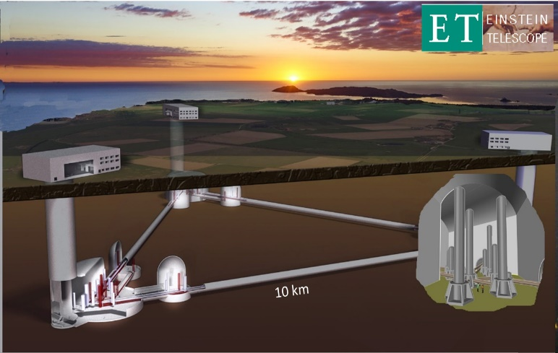
First-order phase transition
For a 5D warped model including a scalar potential
  Stochastic GWs generated by phase transitions can be observed both at the LISA and the Einstein Telescope.
E. Meg´ıas, G. Nardini, and M. Quirós, JHEP 1809, 095 (2018); arXiv:1811.10891
Notes:
At present, the GWs from phase transitions are not very suitable for detecting extra dimensions.

Slide 57
Black strings
A black string is regarded as a brane black hole in the bulk, which is a line singularity connecting our brane and a shadow brane in the bulk.
The most promising events involving GWs are the mergers of black strings and the perturbations of black strings.
This type of GW is usually characterized by a discrete and high-frequency (about ≥ 300 GHz) spectrum.
a brane
black
hole
T. Kobayashi and T. Tanaka, Phys. Rev. D 73, 044005 (2006).
S. S. Seahra, C. Clarkson, and R. Maartens, Phys. Rev. Lett. 94, 121302 (2005).
S. S. Seahra and C. Clarkson, Class. Quant. Grav. 26, 245004 (2009).
A black string
Notes:
These discrete high-frequency GWs could be a very important tool for probing EDs.

Slide 58
Black strings
The discrete spectrum is formed because of the discrete tower of massive KK modes.
The frequency of the spectrum is determined by the bulk curvature radius and the brane separation distance.
In most of the extra-dimensional models, the GWs emitted by black strings have high-frequency spectra.
These discrete high-frequency GWs could be a very important tool for probing extra dimensions.
T. Kobayashi and T. Tanaka, Phys. Rev. D 73, 044005 (2006).
S. S. Seahra, C. Clarkson, and R. Maartens, Phys. Rev. Lett. 94, 121302 (2005).
S. S. Seahra and C. Clarkson, Class. Quant. Grav. 26, 245004 (2009).
Notes:
These discrete high-frequency GWs could be a very important tool for probing EDs.

Slide 59
Shortcut in extra dimensions——AdS₅
In extra-dimensional theories, it is generally accepted that GWs can propagate throughout the higher dimensional space, while the other matters and interactions are trapped on a three-brane.
The speed of GWs in different extra-dimensional models may have different values, and there are many factors that can affect the propagation of GWs in the bulk, such as the size and number of extra dimensions.
Here, we suppose that the speed of GWs travel in the bulk is equal to the speed of light on the brane.
Notes:
In brane theory, GWs travel in the bulk space, but EMWs travel on the brane.
So, GWs can go the shortest null path in the bulk which is also called “shortcut”.

Slide 60
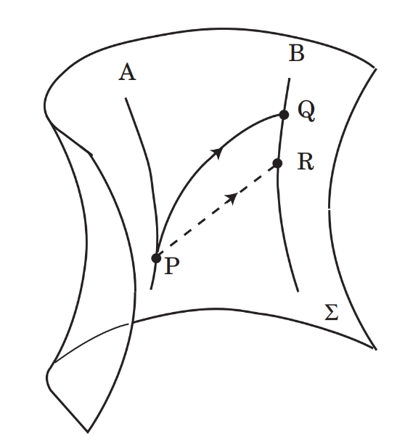
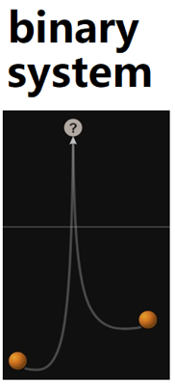
Shortcut in extra dimensions——AdS₅
In brane theory, GWs travel in bulk space, while EMWs travel on brane.
So, GWs can go the shortest null path in the bulk which is also called “shortcut”.
A brane Universe embedded in AdS₅ would allow GWs to have a shortcut through extra dimensions.
  H. Ishihara, PRL 86 (2001) 381; R. Caldwell and D. Langlois, PLB 511 (2001) 129].
  E. Abdalla, B. Cuadros-Melgar, S.S. Feng, and B. Wang, PRD 65 (2002) 083512.
  H. Yu, B.M. Gu, F.P. Huang, Y.Q. Wang, X.H. Meng, and YXL, JCAP 1702 (2017) 039.
Notes:
In brane theory, GWs travel in the bulk space, but EMWs travel on the brane.
So, GWs can go the shortest null path in the bulk which is also called “shortcut”.

Slide 61
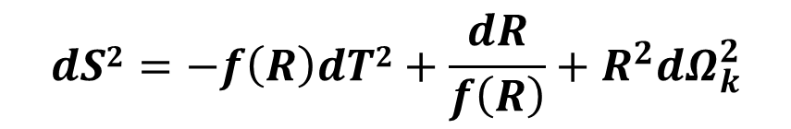
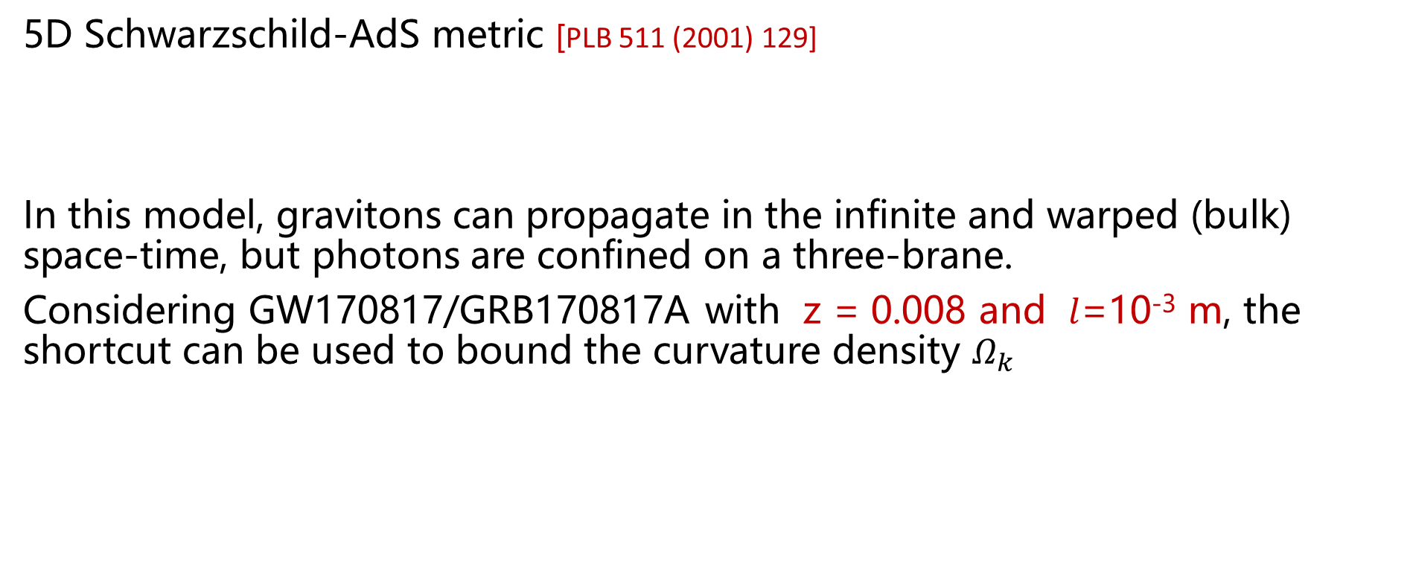

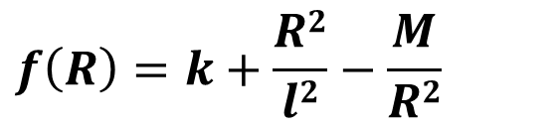
Shortcut in extra dimensions ——AdS₅
5D Schwarzschild-AdS metric [PLB 511 (2001) 129]
In this model, gravitons can propagate in the infinite and warped (bulk) space-time, but photons are confined on a three-brane.
Considering GW170817/GRB170817A with z = 0.008 and $l$=10⁻³ m, the shortcut can be used to bound the curvature density $Ω_{k}$
$$dS2=−f\left(R\right)dT2+\frac{dR}{f\left(R\right)}+R^{2}dΩ_{k}^{2}$$
$$f\left(R\right)=k+\frac{R2}{l2}−\frac{M}{R2}$$
$$Ω_{k}≤{10}^{−10}$$
  H. Yu, YXL et al, JCAP 1702 (2017) 039.
  In Planck Collaboration, Astron. Astrophys. 594, A13 (2016)， the bound is

Slide 62


Shortcut---the AdS₅ radius
The shortcut was also used to bound the AdS₅ radius as
at $68\%$confidence level.
$$l≤0.5 Mpc$$
L. Visinelli, N. Bolis, and S. Vagnozzi, PRD 97 (2018) 064039.
Notes:
Although this result is not competitive, this work provides a proof-of-principle of the possibility of using multi-messenger astronomy for probing the geometry of our space-time.

Slide 63

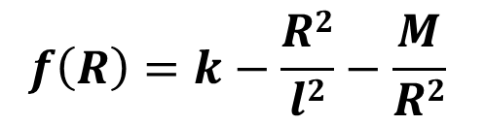
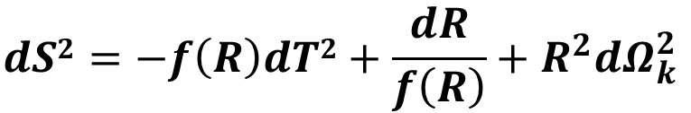

Shortcut---the dS₅ radius
5D Schwarzschild-dS metric
$$dS2=−f\left(R\right)dT2+\frac{dR}{f\left(R\right)}+R^{2}dΩ_{k}^{2}$$
$$f\left(R\right)=k−\frac{R2}{l2}−\frac{M}{R2}$$
The dS₅ radius was bounded as
$$l>2×{10}^{3}Tpc$$
$∧$CDM model
  Z.C. Lin(林子超), H. Yu(喻豪), and YXL, PRD 101 (2020) 104058.

Slide 64
Shortcut---Note
Shortcut is not a general nature,
e.g., no shortcut in RS-1 model
Shortcut depends on a set of
conditions in a 6D brane model
[Bin Wang et al, PRD 65 (2002) 083512] .
RS-I model
Notes:
In certain extra-dimensional models (such as RS models), there is no shortest path in the bulk and the shortest cut is only present on the brane [66].

Slide 65
6. Prospect

Slide 66
6. Prospect
Number of extra dimensions
I. M. Hernandez, Constraining the number of spacetime dimensions from GWTC-3 binary black hole mergers, arXiv: 2112.07650 [astro-ph.HE].
B. P. Abbott et al. (LIGO and Virgo Collaborations), Tests of General Relativity with GW170817, Phys. Rev. Lett. 123 (2019) 011102.
K. Pardo, M. Fishbach, D. E. Holz, and D. N. Spergel, Limits on the number of spacetime dimensions from GW170817, JCAP 1807 (2018) 048.
Notes:
In De Sitter and Einstein-de Sitter models, the GW signal can always be detected earlier than the EMW signal and the values of the parameters are not against the current observation and experiment.

Slide 67
6. Prospect
Size of extra dimensions
Z.C. Lin (林子超), H. Yu (喻豪), and YXL, Shortcut in codimension-2 brane cosmology in light of GW170817, Eur. Phys. J. C 83 (2023) 190 [arXiv: 2202.04866 [gr-qc].
Wen-Hai Tan, An-Bin Du, Wen-Can Dong, Shan-Qing Yang, Cheng-Gang Shao, Sheng-Guo Guan, Qing-Lan Wang, Bi-Fu Zhan, Peng-Shun Luo, Liang-Cheng Tu, and Jun Luo, Improvement for Testing the Gravitational Inverse-Square Law at the Submillimeter Range, Phys. Rev. Lett. 124 (2020) 051301.
Notes:
In De Sitter and Einstein-de Sitter models, the GW signal can always be detected earlier than the EMW signal and the values of the parameters are not against the current observation and experiment.

Slide 68
6. Prospect
Particle physics in LHC
Avnish, K. Ghosh, T. Jha, and S Niyogi, Minimal and non-minimal Universal Extra Dimension models in the light of LHC data at 13 TeV, Phys. Rev. D 103 (2021) 115011.
N. Deutschmann, T. Flacke, and J.S. Kim, Current LHC Constraints on Minimal Universal Extra Dimensions, Phys. Lett. B 771 (2017) 515-520.
Notes:
In De Sitter and Einstein-de Sitter models, the GW signal can always be detected earlier than the EMW signal and the values of the parameters are not against the current observation and experiment.

Slide 69
6. Prospect
Black hole in brane model
W. D. Biggs and J. E. Santos, Rotating Black Holes in Randall-Sundrum II Braneworlds, Phys. Rev. Lett. 128 (2022) 021601, arXiv: 2108.00016 [hep-th]].
T. Nakas and P. Kanti, Analytic and exponentially localized braneworld Reissner-Nordström-AdS solution: A top-down approach, Phys. Rev. D 104 (2021) 104037, arXiv: 2105.06915 [hep-th].
I. Sakallı and S. Kanzi, Physical Properties of Brane-World Black Hole Solutions via a Confining Potential, Annals Phys. 439 (2022) 168803 [arXiv: 2201.00537 [hep-th]].
Notes:
In De Sitter and Einstein-de Sitter models, the GW signal can always be detected earlier than the EMW signal and the values of the parameters are not against the current observation and experiment.

Slide 70
6. Prospect
The Black Hole Information Problem
G. Grimaldi, J. Hernandez, and R. C. Myers, Quantum Extremal Islands Made Easy, Part IV: Massive Black Holes on the Brane, JHEP 03 (2022) 136 [arXiv: 2202.00679].
J. Chu, F. Deng, and Y. Zhou, Page curve from defect extremal surface and island in higher dimensions, JHEP 10 (2021) 149 [2105.09106].
J. Hernandez, R. C. Myers and S.-M. Ruan, Quantum extremal islands made easy. Part III. Complexity on the brane, JHEP 02 (2021) 173 [2010.16398].
G. Penington, Entanglement Wedge Reconstruction and the Information Paradox, JHEP 09 (2020) 002 [1905.08255].
Y. Ling, Y. Liu and Z.-Y. Xian, Island in Charged Black Holes, JHEP 03 (2021) 251.
S. He, Y. Sun, L. Zhao, and Y.X. Zhang, The universality of islands outside the horizon, JHEP 05 (2022) 047 [arXiv: 2110.07598].
M.H. Yu, and X.H. Ge, Islands and Page curves in charged dilaton black holes, Eur. Phys. J. C 82 (2022) 14, arXiv: 2107.03031
Q.L. Hu, D. Li, R.X. Miao, and Y.Q. Zeng, AdS/BCFT and Island for curvature-squared gravity, JHEP 09 (2022) 037 [2202.03304].
Notes:
In De Sitter and Einstein-de Sitter models, the GW signal can always be detected earlier than the EMW signal and the values of the parameters are not against the current observation and experiment.

Slide 71
6. Prospect
Black hole shadow in extra dimension/brane models
I. Banerjee, S. Chakraborty, S. SenGupta, Hunting extra dimensions in the shadow of Sgr A*, Phys. Rev. D 106 (2022) 084051 [arXiv: 2207.09003].
Yehui Hou, Minyong Guo, Bin Chen, Revisiting the shadow of braneworld black holes, Phys. Rev. D 104 (2021) 024001.
H.R. Zhang, P.Z. He, L. Shao, Y. Chen, and X.R. Hu, Shadow of topologically charged rotating braneworld black hole, Mod.Phys.Lett.A 37 (2022) 2250145 [arXiv:2101.01374].
E. F. Eiroa, C. M. Sendra, Shadow cast by rotating braneworld black holes with a cosmological constant, Eur. Phys. J. C 78 (2018) 91.
L. Amarilla and E. F. Eiroa, Shadow of a rotating braneworld black hole, Phys. Rev. D 85 (2012) 064019.
Fen Long, Jieci Wang, Songbai Chen, and Jiliang Jing, Shadow of a rotating squashed Kaluza-Klein black hole, JHEP 10 (2019) 269, arXiv: 1906.04456.
Notes:
In De Sitter and Einstein-de Sitter models, the GW signal can always be detected earlier than the EMW signal and the values of the parameters are not against the current observation and experiment.

Slide 72
6. Prospect
Collisional Penrose process & energy extraction
S.W. Wei, H.M. Wang, Y.P. Zhang, and Y.X. Liu, Effects of tidal charge on magnetic reconnection and energy extraction from spinning braneworld black hole, JCAP 04 (2022) 050 [arXiv: 2201.12729].
Yongbin Du, Yunlong Liu, and Xiangdong Zhang, Collisional Penrose process with spinning particles in braneworld black hole, Eur. Phys. J. C 82 (2022) 871 [arXiv: 2108.05116].
Notes:
In De Sitter and Einstein-de Sitter models, the GW signal can always be detected earlier than the EMW signal and the values of the parameters are not against the current observation and experiment.

Slide 73
6. Prospect
Other topics
T.N. Hung and C.H. Nam, Compactified extra dimension and entanglement island as clues to quantum gravity, arXiv: 2303.00348.
J.J. Wan and Y.X. Liu, Localization of Fermions on a Thick Brane in Six-Dimensional Spacetime, arXiv: 2303.06278.
C.C. Zhu, Q. Tan, Y.P. Zhang, and Y.X. Liu, Evolution of Fermion Resonance in Thick Brane, arXiv: 2304.04479.
Q. Tan, W.D. Guo, Y.X. Liu, Sound from extra dimension: quasinormal modes of thick brane, Phys. Rev. D 106 (2022) 044038 [arXiv: 2205.05255].
Q. Tan, Y.P. Zhang, W.D. Guo, J. Chen, C.C. Zhu, Y.X. Liu, Evolution of scalar field resonances on braneworld, Eur. Phys. J. C 83 (2023) 84 [arXiv: 2203.00277].
Notes:
In De Sitter and Einstein-de Sitter models, the GW signal can always be detected earlier than the EMW signal and the values of the parameters are not against the current observation and experiment.

Slide 74
Thank you !

Slide 75


Shortcut---the AdS₆ radius
The AdS₆ radius would be bounded as
$$l<2 Mpc$$
GW170817/GRB 170817A
$$l<0.1 Mpc$$
DECIGO and BBO
  Z.C. Lin (林子超), H. Yu (喻豪), and YXL, arXiv: 2202.04866 [gr-qc].

Slide 76
Gravitational leakage
In 4D (GR)
the strain goes as
Extra dimensions
GWs can leak into extra dimensions
R_{c}: Screening radius
K. Pardo, M. Fishbach, D. E. Holz, and D. N. Spergel, JCAP 1807 (2018) 048.

Slide 77
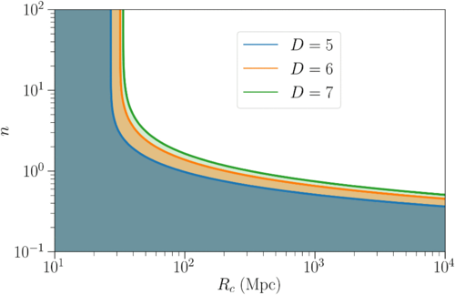
Gravitational leakage
n
R_{c} > 40 Mpc
R_{c}(Mpc)
B. P. Abbott et al. (LIGO and Virgo Collaborations), Phys. Rev. Lett. 123 (2019) 011102.
K. Pardo, M. Fishbach, D. E. Holz, and D. N. Spergel, JCAP 1807 (2018) 048.
Notes:
By comparing the inferred distance to GW170817 from the observation of GWs with the inferred distance to the electromagnetic counterpart, the parameters of Eds can be constrained.
Though the result is fully consistent with GR, however, they only considered waveforms that are the same as GR, up to some overall multiplicative factor. It could
be possible to evade these constraints by changing the waveforms in other ways.
这篇文章的作者
Kris Pardo Princeton University
Maya Fishbach University of Chicago
Daniel E. Holz University of Chicago
David N. Spergel Stanford University

